Slide 1
Land Preservation in Honey Brook Township
Shane Hadden

Slide 3
Thank you!
(Not the end yet)

Slide 4
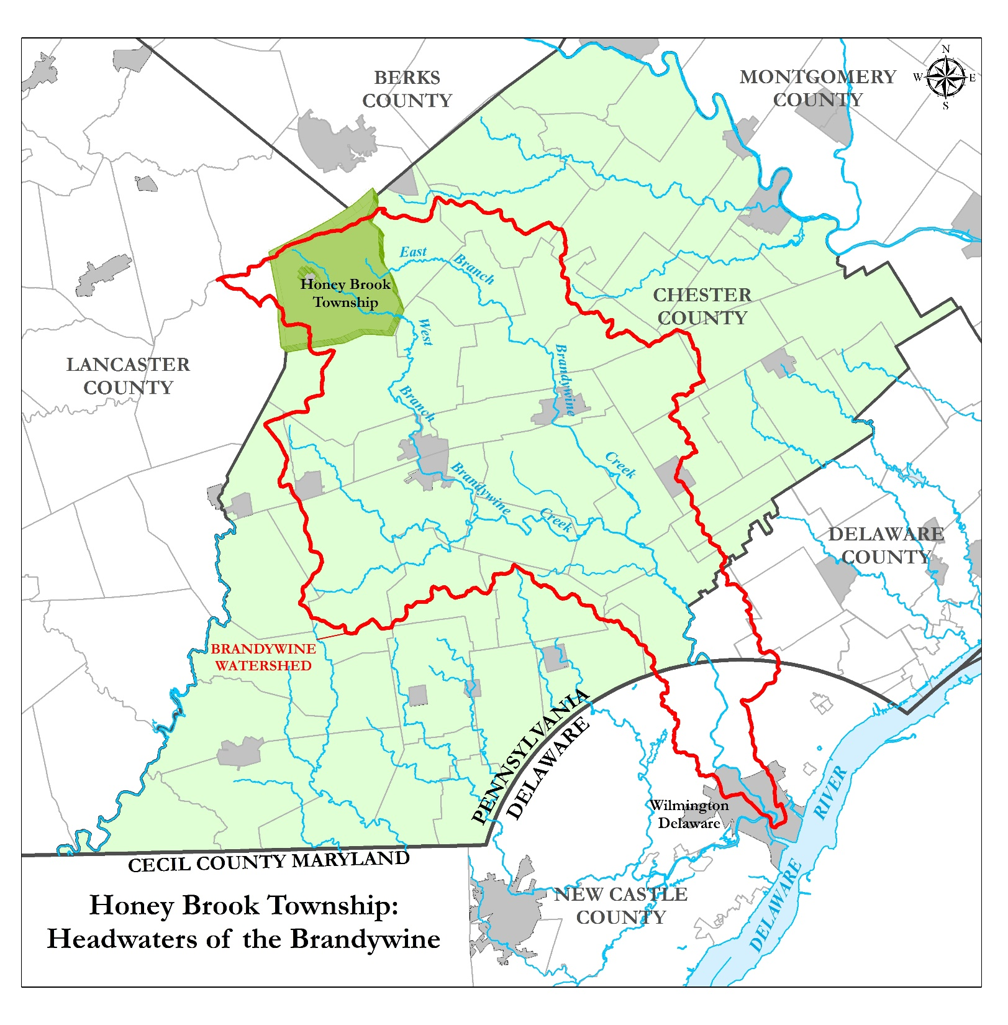

Slide 5
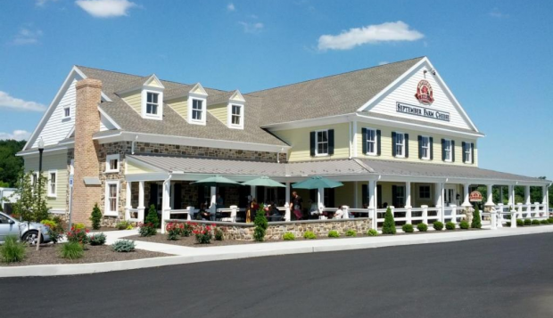

Slide 6
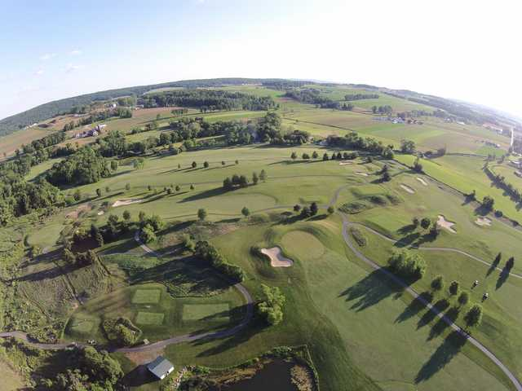

Slide 7
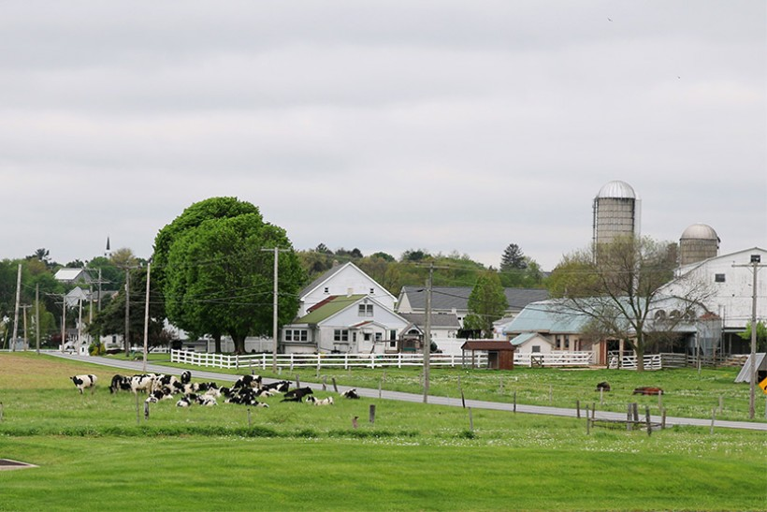

Slide 8
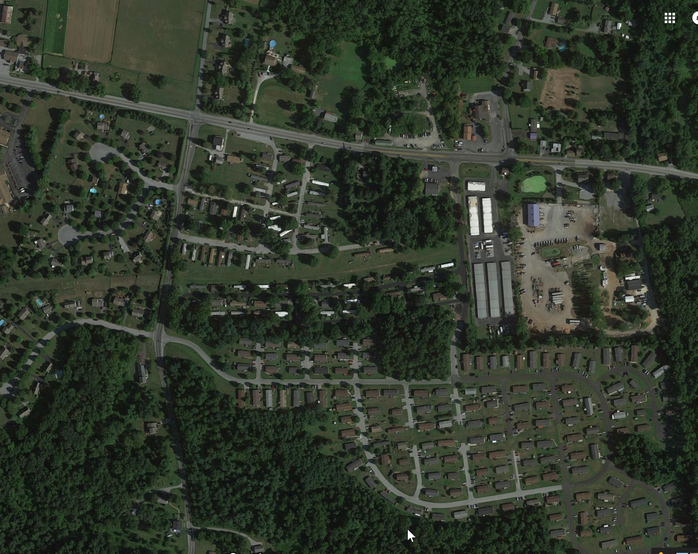

Slide 9
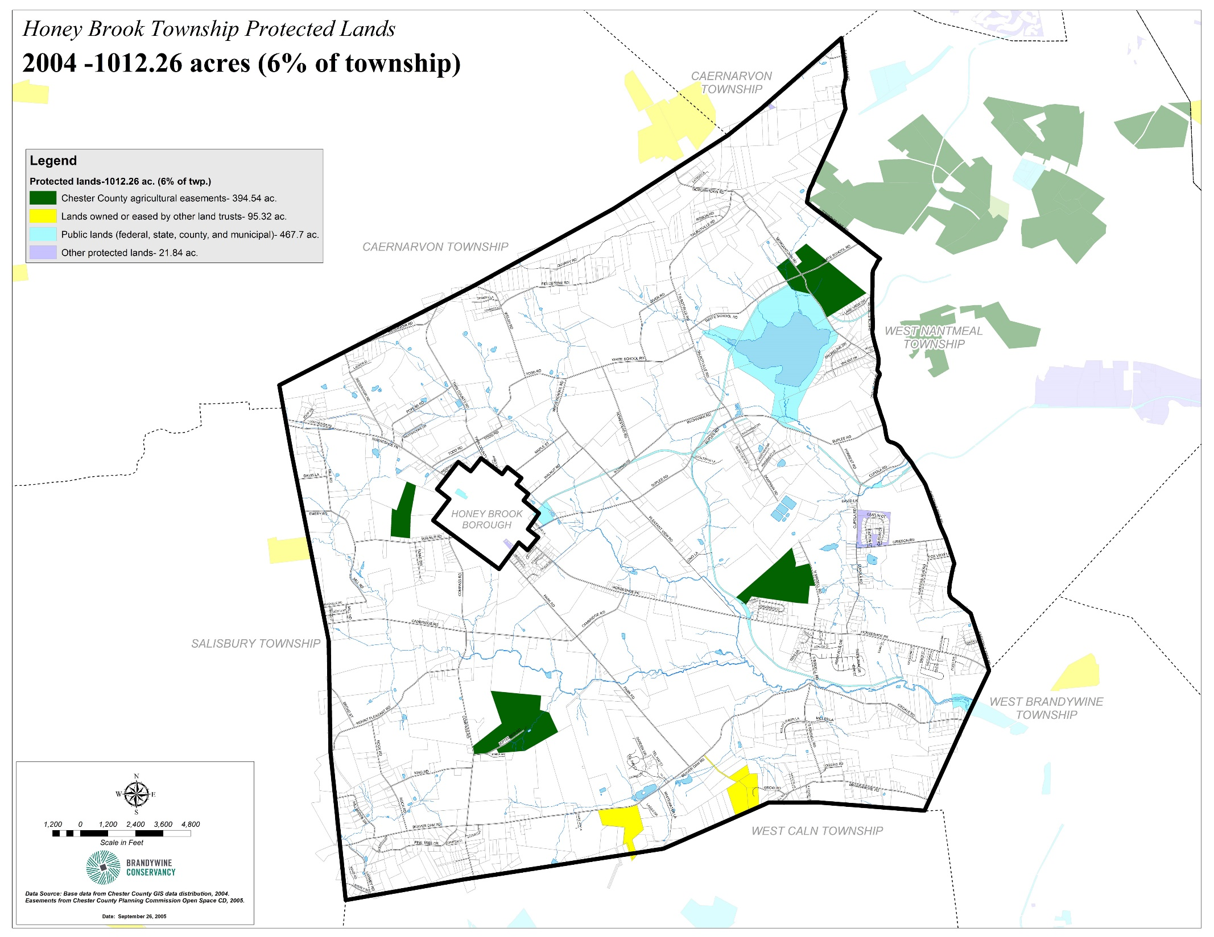

Slide 10
Land Preservation Program
Referendum – 0.5% Earned Income Tax
Committee Formation
Preservation Process

Slide 11
Program Growth
Funding sources expanded
Applications steady each year ~400ac
All kinds of farms and lands
Plain Sect (Amish) participation

Slide 12
Progress

Slide 14
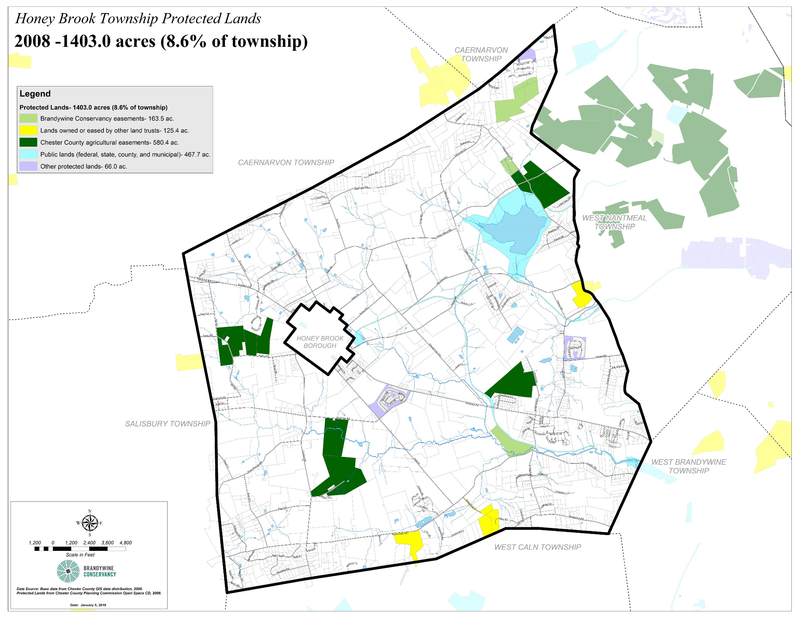

Slide 15
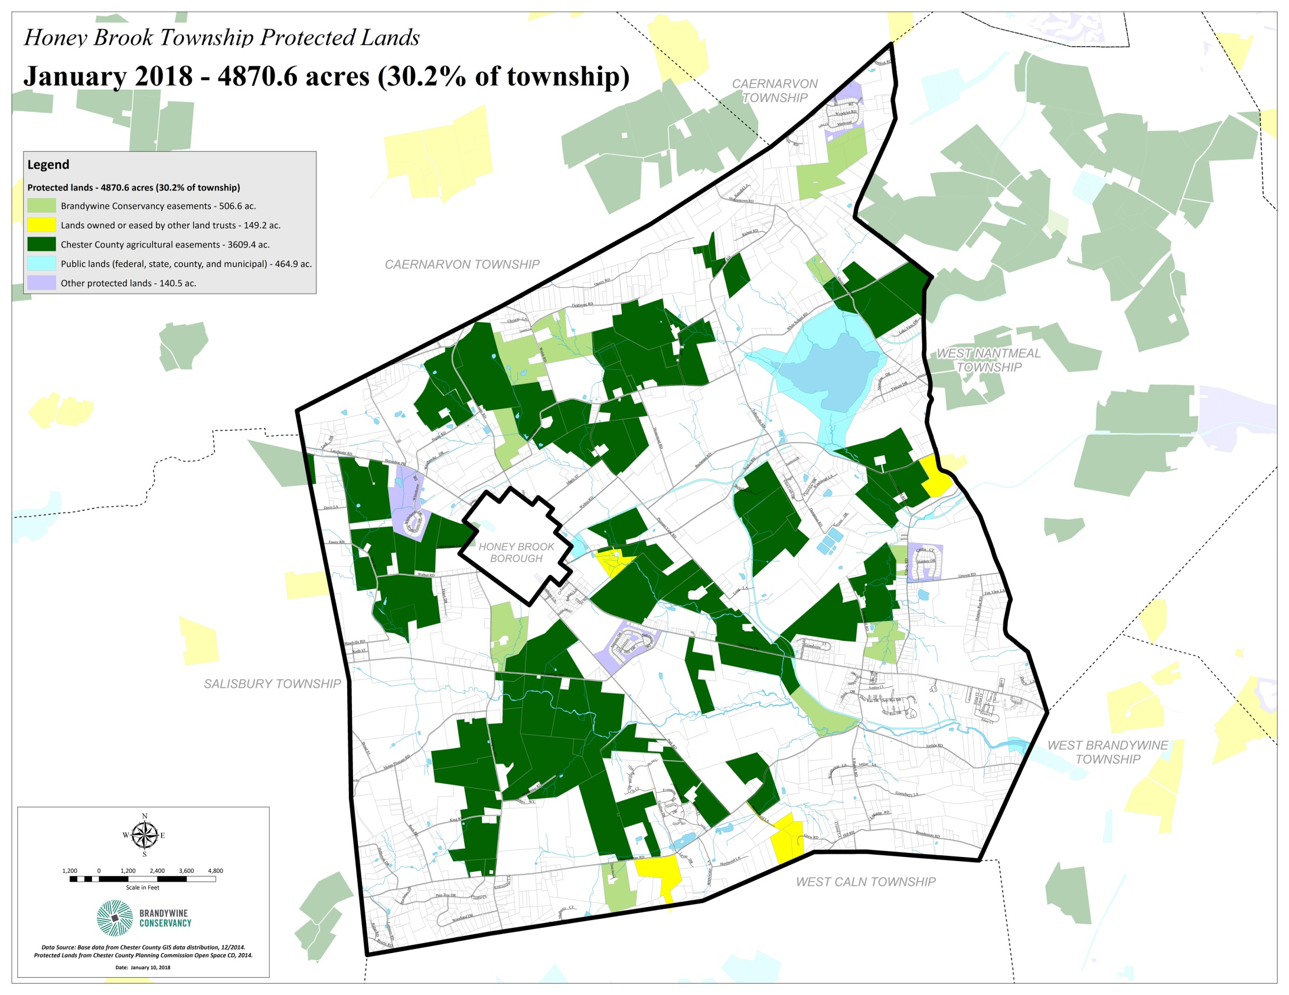

Slide 16
Why is preservation a good investment?

Slide 17
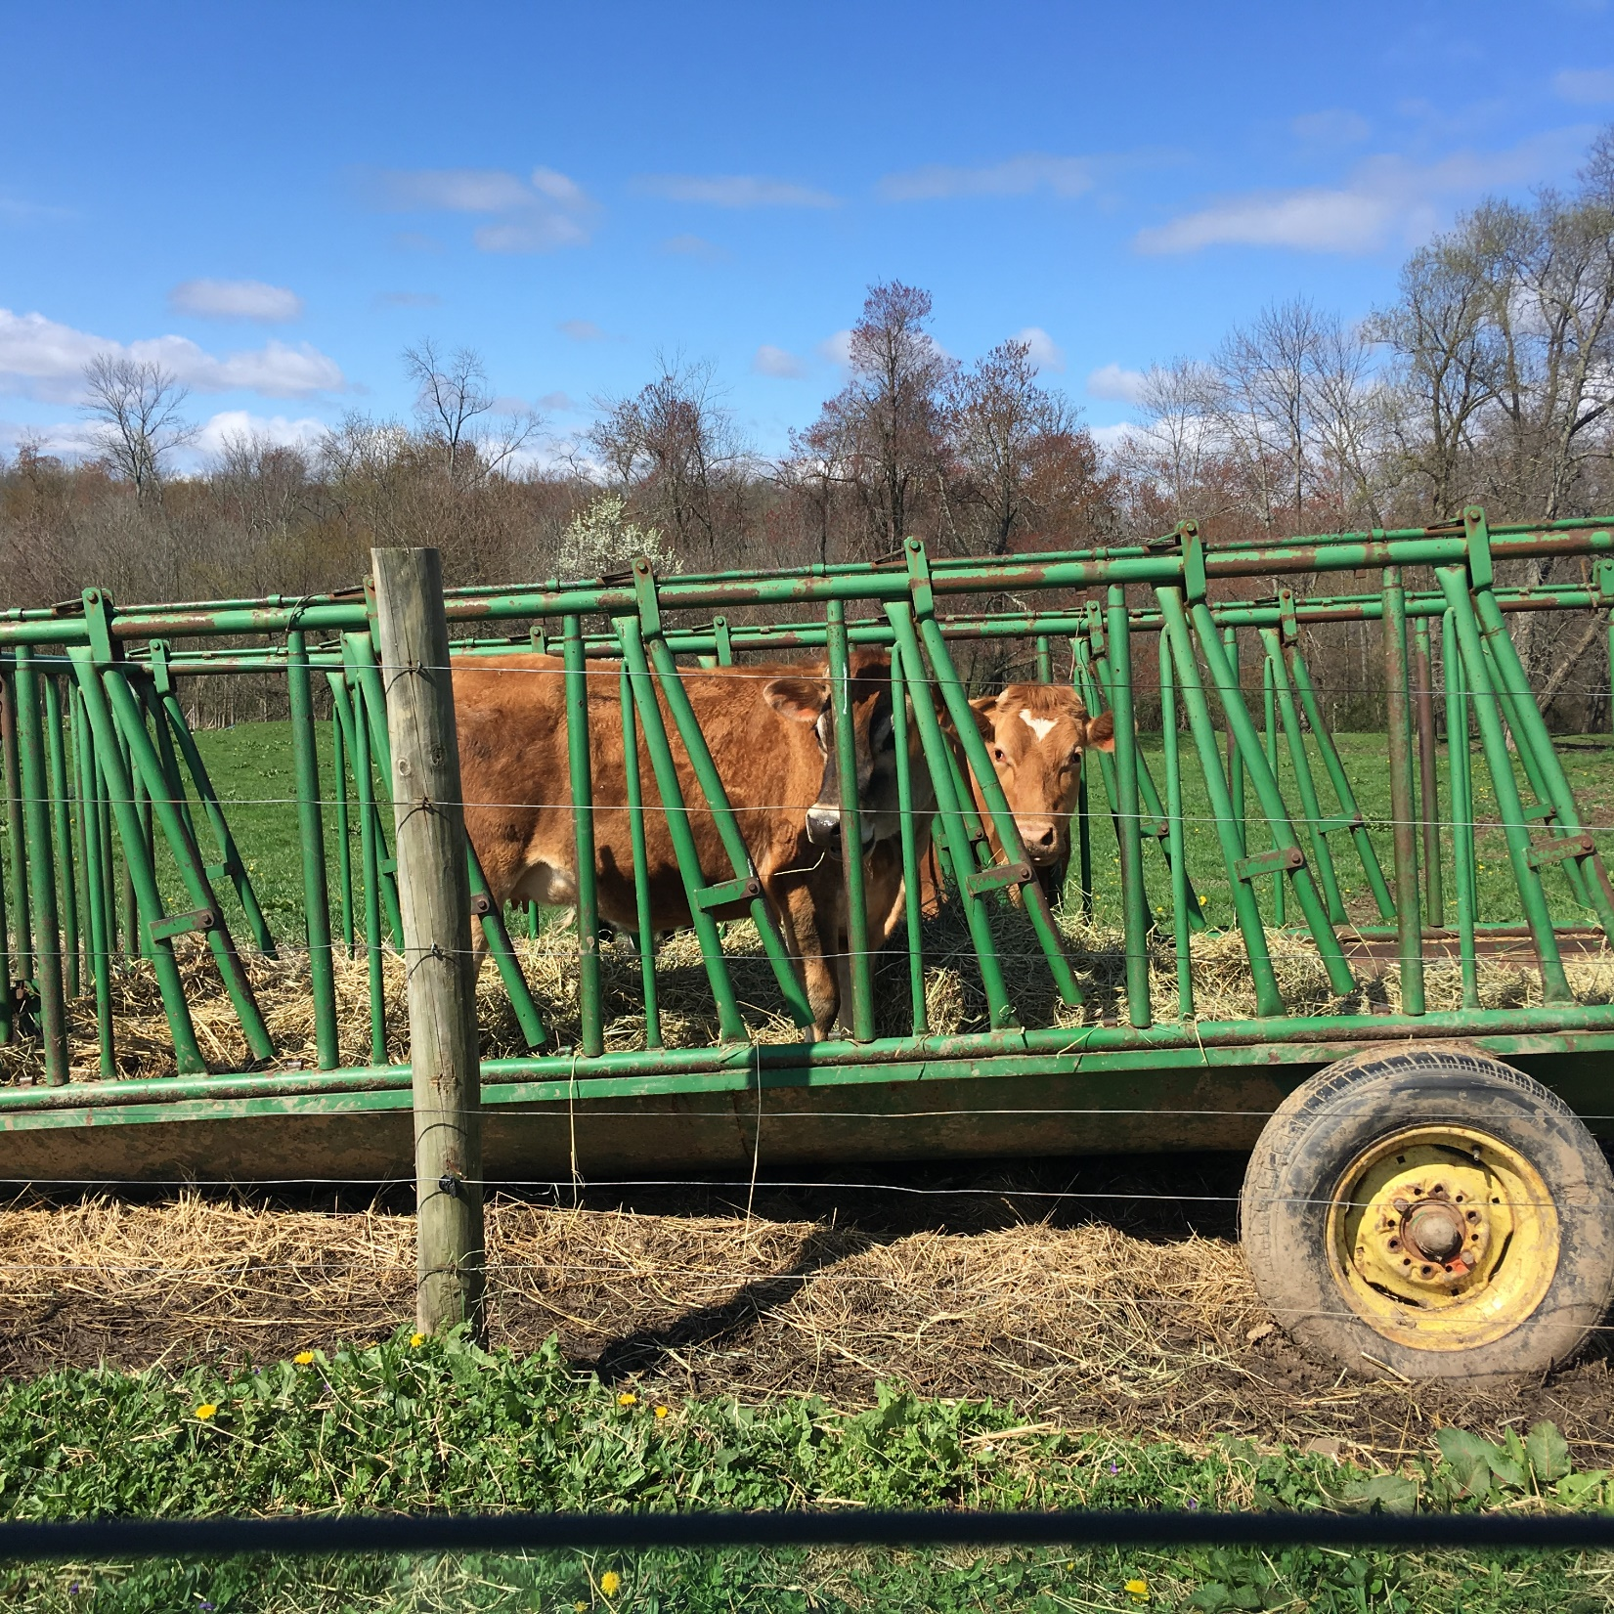

Slide 18
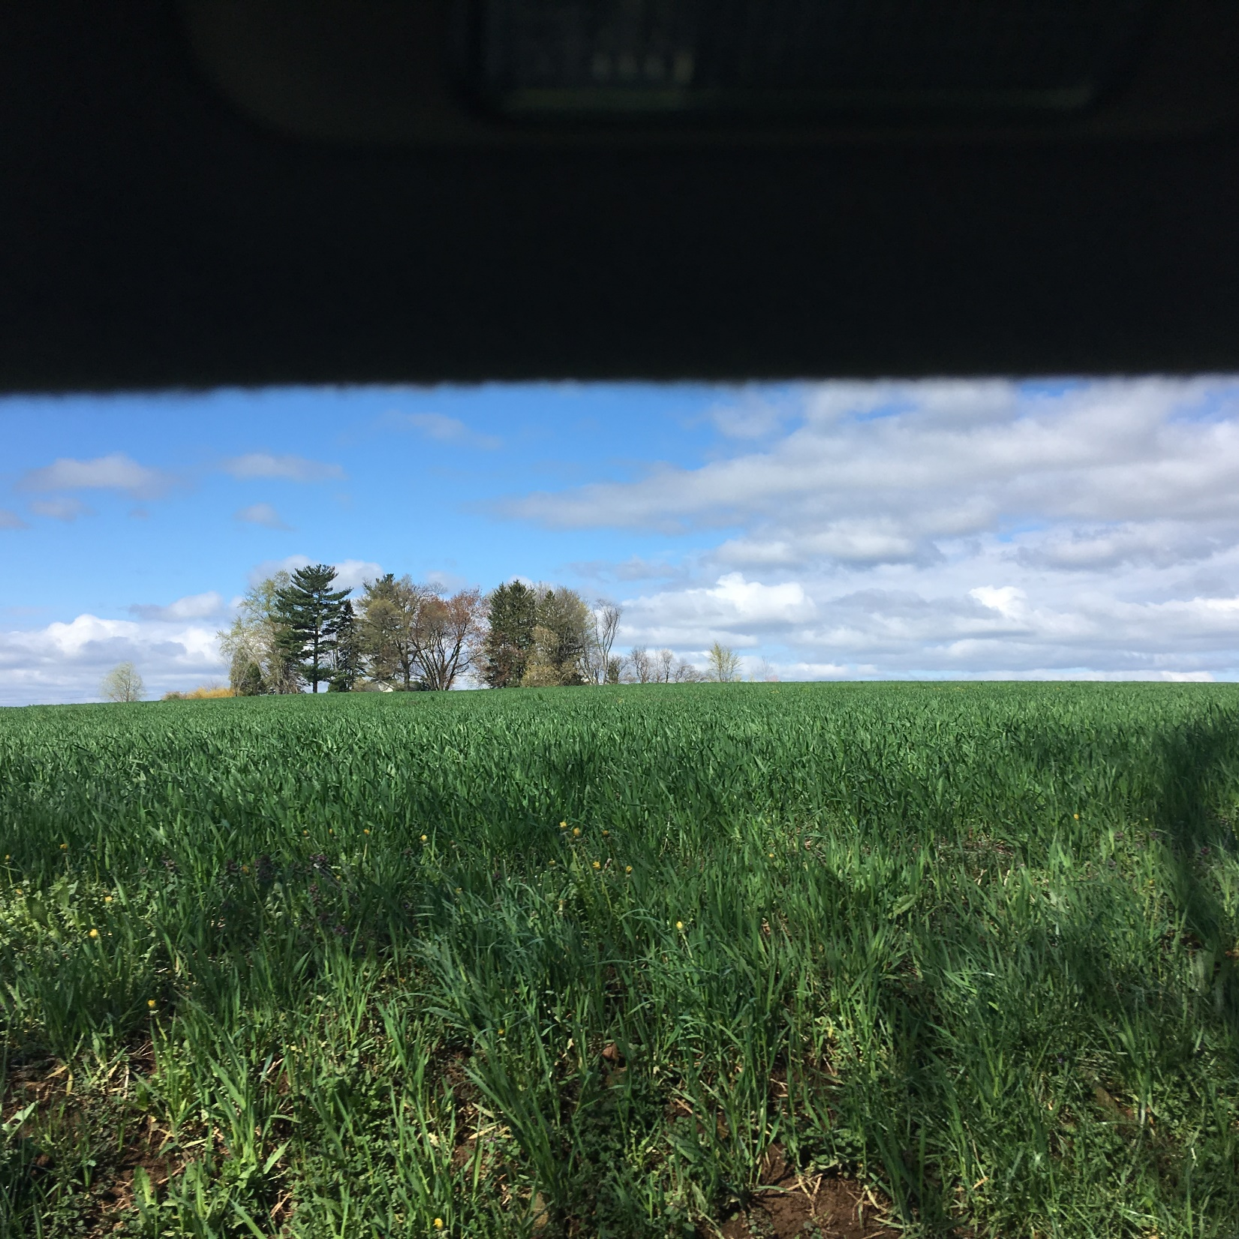

Slide 19
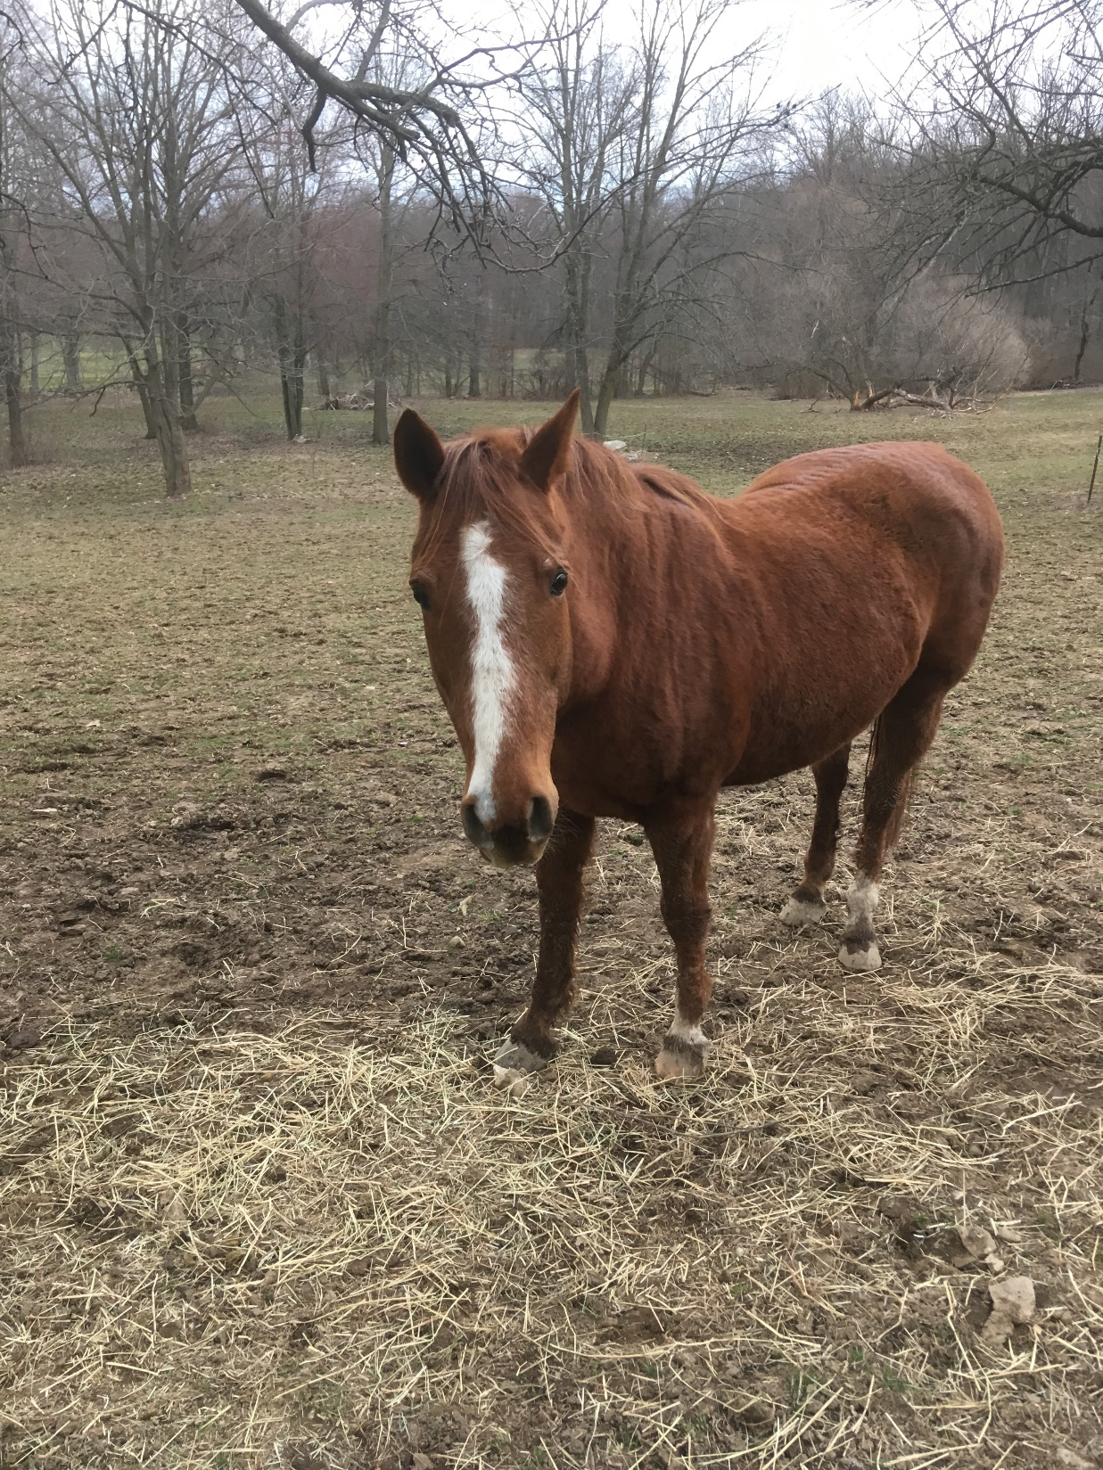

Slide 20
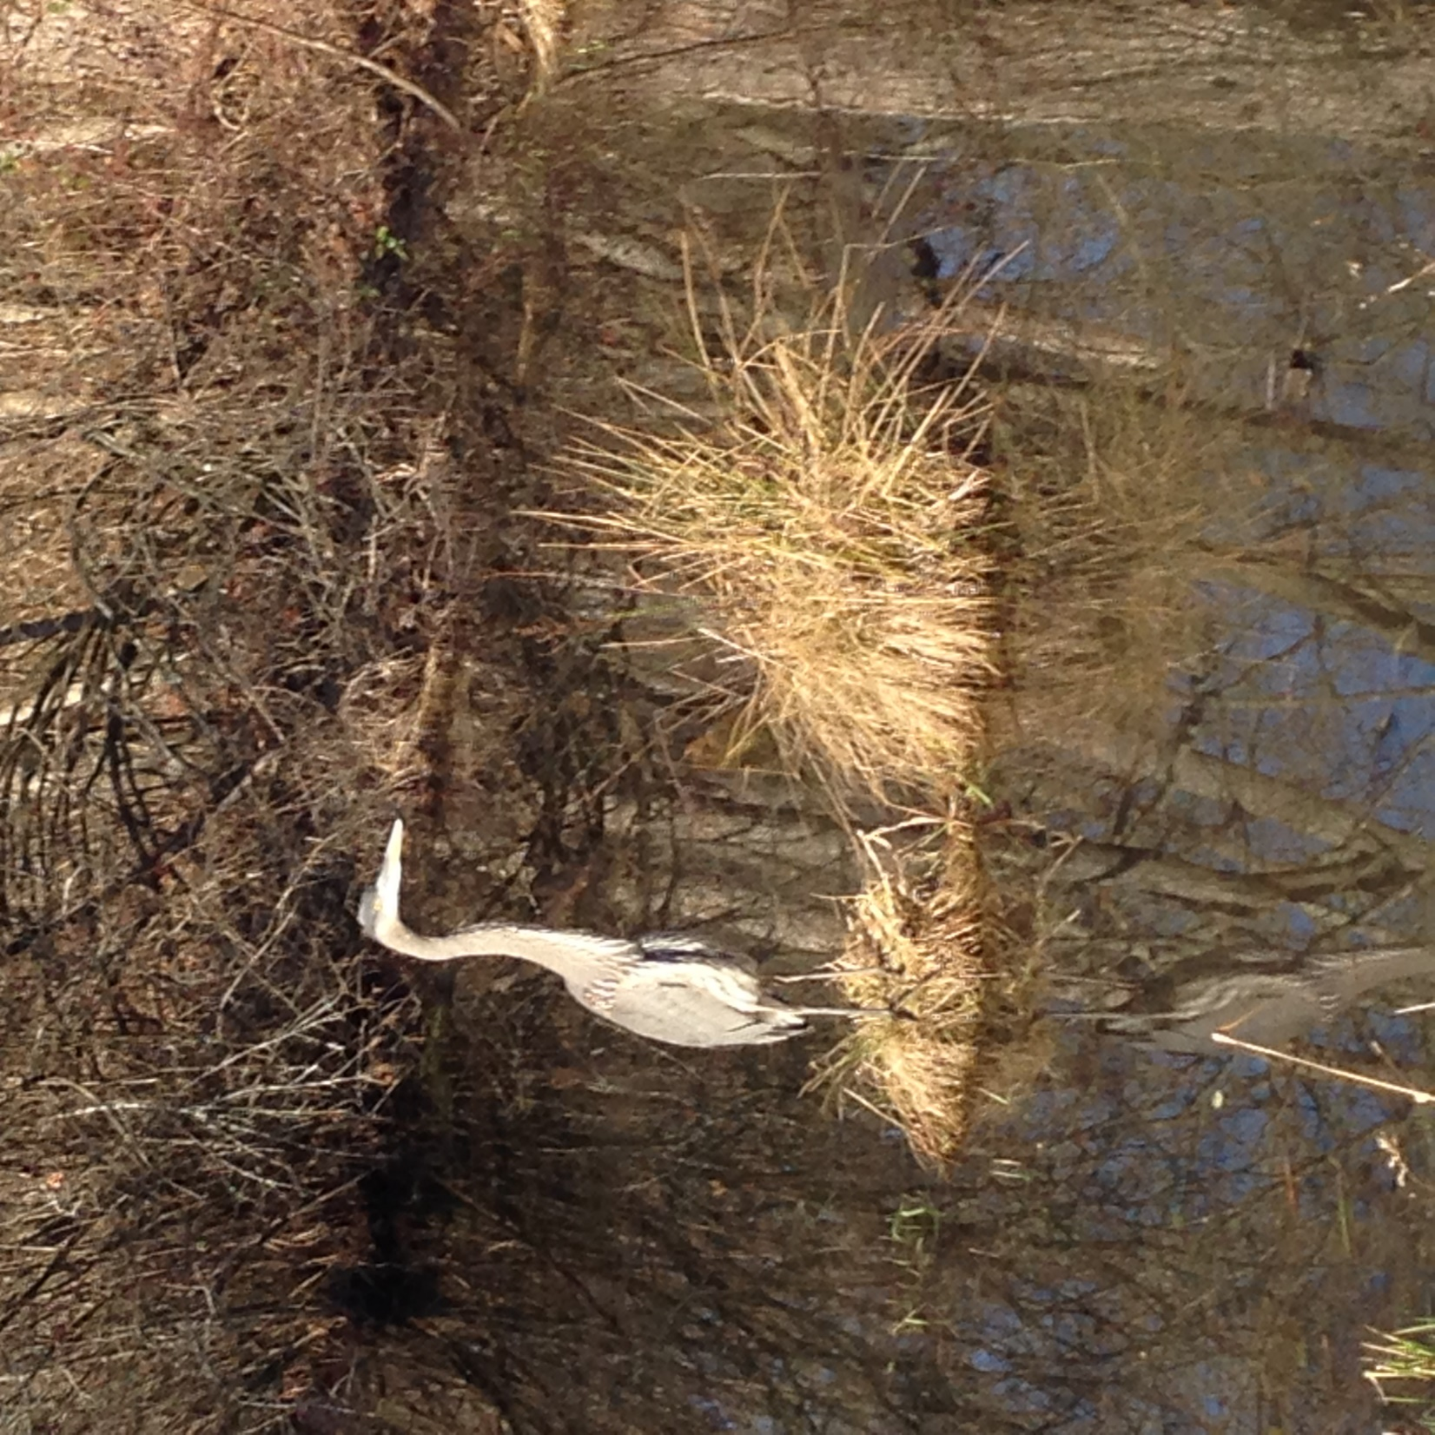

Slide 21
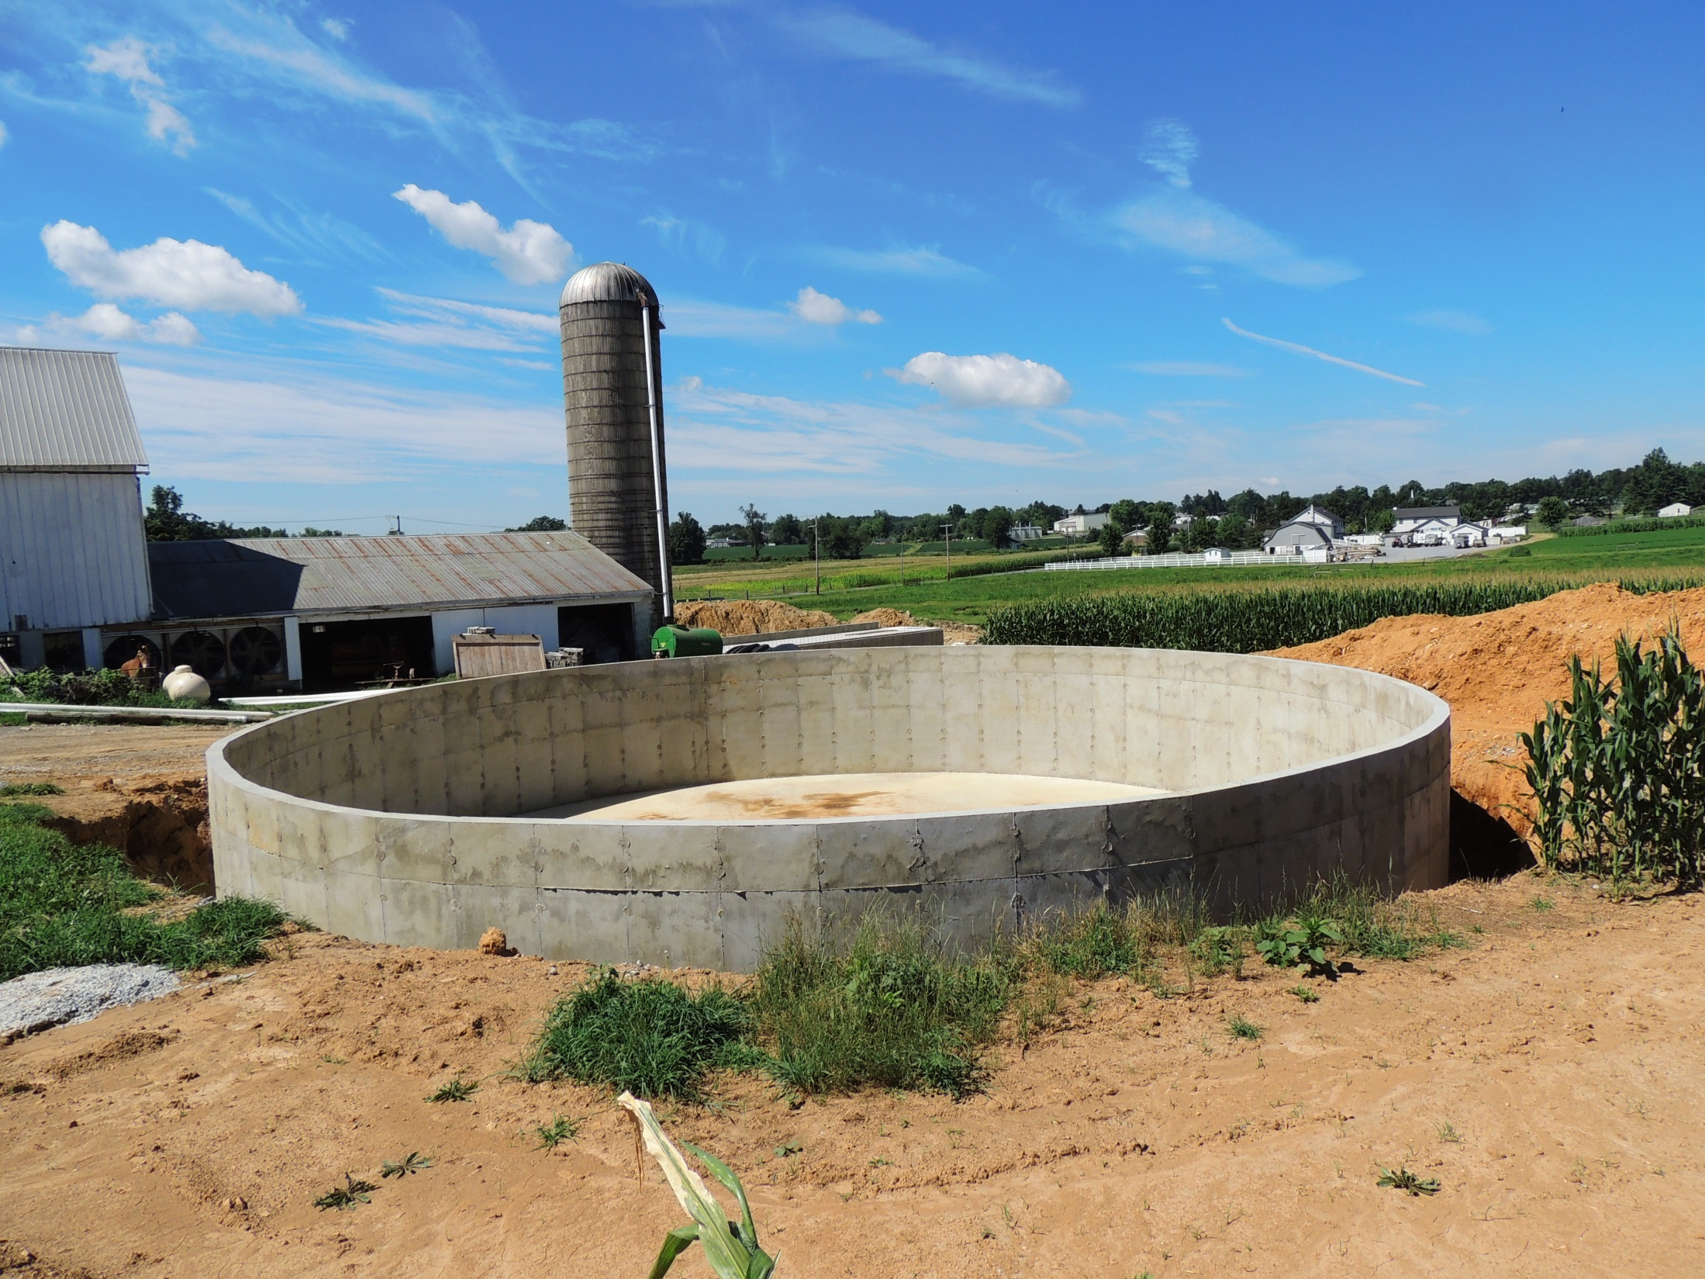

Slide 22
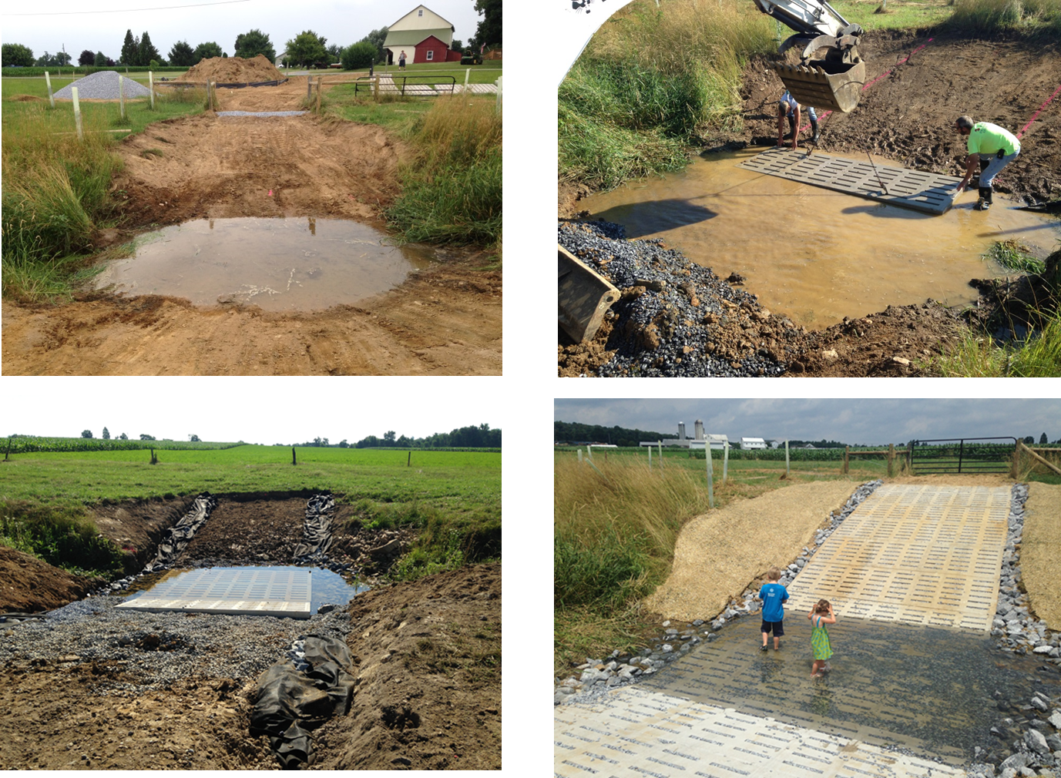

Slide 23
Next

Slide 24
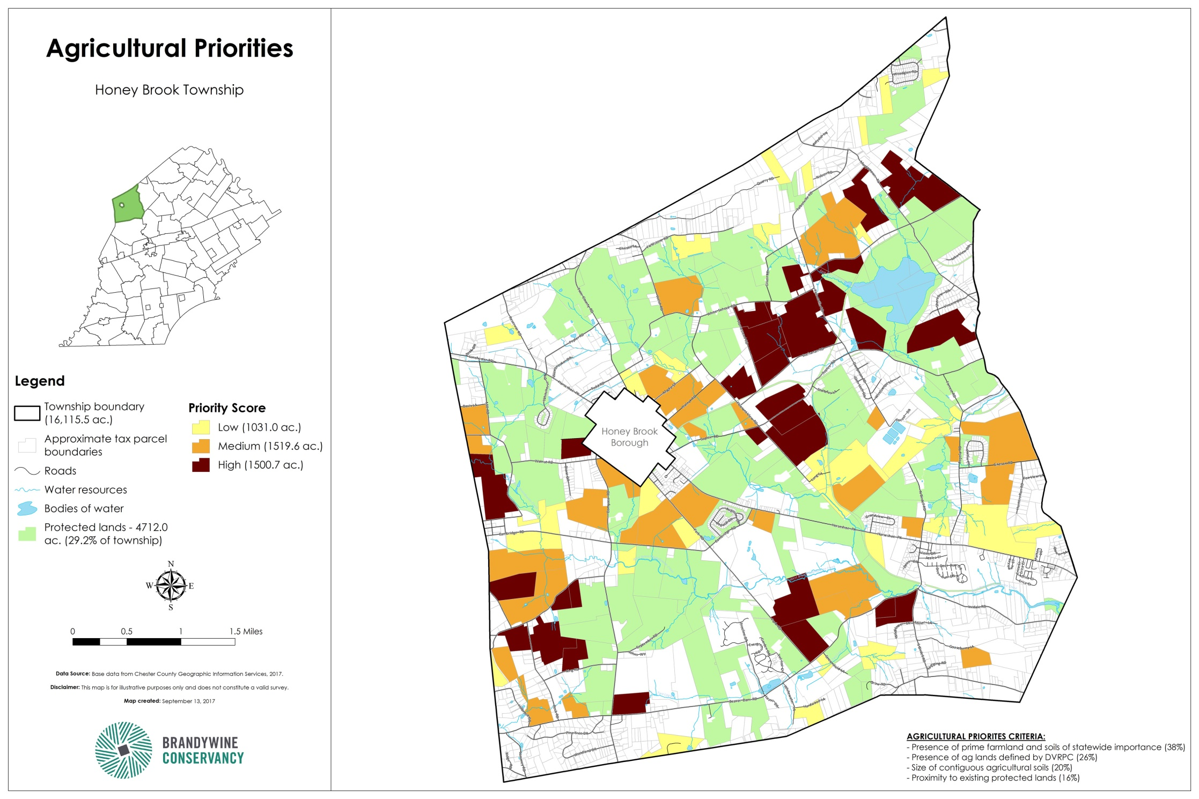

Slide 25
At the current rate of preservation, we could have all priority lands preserved in 12 more years. 63% of the Township

Slide 26
Thank you!
(Last slide this time)

